Slide 1

Airbnb Hotel Booking Analysis
Name : Jishnu sai reddy Aicte id: STU65839b93cdfbd1703123859

Slide 2

PROBLEM STATEMENT
The hospitality sector is being revolutionized by online booking platforms, with Airbnb at the forefront.
Airbnb offers a commission based lodging service ,Connecting hosts and travellers worldwide without directly owning properties.
The goal is analyze Airbnb’s impact and extract actionable insights using data from new York city,One of the Airbnb’s key markets.
Rise of online platforms transforming the hospitality industry.
Airbnb enables diverse and unique lodging globally.
Focus: New York city airbnb data for insights into lodging dynamics.

Slide 3
Project Description
The project begins with an in-depth EDA of New York City's Airbnb listings data, uncovering patterns in room types, host activities, neighborhood popularity, and price distribution across thousands of listings.
Analysis focuses on critical variables such as location, room type, property characteristics, and amenities to determine how they influence booking rates, listing prices, and overall guest satisfaction.
The project examines how various factors—such as neighborhood, property type, seasonal trends, and service fees—affect nightly pricing, using statistical and machine learning techniques to predict price and identify significant correlations.
Investigation into host characteristics (listing count, verification status) and guest behaviors (length of stay, preferences, review patterns) uncovers what drives higher ratings, positive reviews, and repeat bookings.
Insights from the project offer value to hosts (in optimizing listing strategy and pricing), guests (in choosing best-fit accommodations), and the Airbnb platform (in improving recommendation and pricing algorithms), supporting better decision-making throughout the ecosystem.

Slide 4

WHO ARE THE END USERS?
Airbnb Hosts: They use insights from the analysis to optimize their listing strategies, adjust pricing, improve amenities, and enhance guest satisfaction for increased bookings and better reviews.
Potential Guests/Travelers: Guests benefit by identifying the best neighborhoods, properties, and amenities suited to their preferences, leading to more informed booking decisions.
Airbnb Platform/Management: The Airbnb company leverages the findings to refine recommendation algorithms, set optimal pricing, and improve overall user experience on the platform.
Market Analysts and Researchers: Academic or industry analysts use the project’s results to understand market trends, forecast demand, and study urban tourism patterns.
City Planners and Policymakers: Local authorities and urban planners can use the insights for urban development, policy creation, and monitoring the economic impact of short-term rentals.

Slide 5

Technology Used
Python Programming Language: Used for data wrangling, analysis, and building predictive models with libraries like pandas, NumPy, and scikit-learn.
Jupyter Notebook: Provides an interactive development environment for exploratory data analysis, visualization, and documentation.
Data Visualization Tools: Libraries such as Matplotlib, Seaborn, and Plotly are used to create plots, charts, and maps for analyzing booking patterns and price trends.
SQL: Employed for querying, aggregating, and preparing large datasets from the Airbnb database or CSV files.
Machine Learning Algorithms: Regression, clustering, and classification algorithms help predict prices, categorize hosts and guests, and identify trends in the data.

Slide 6
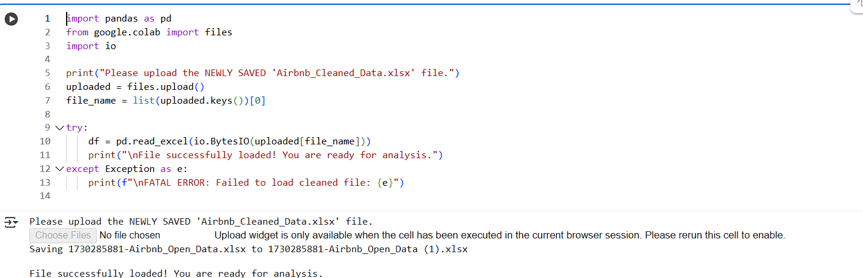
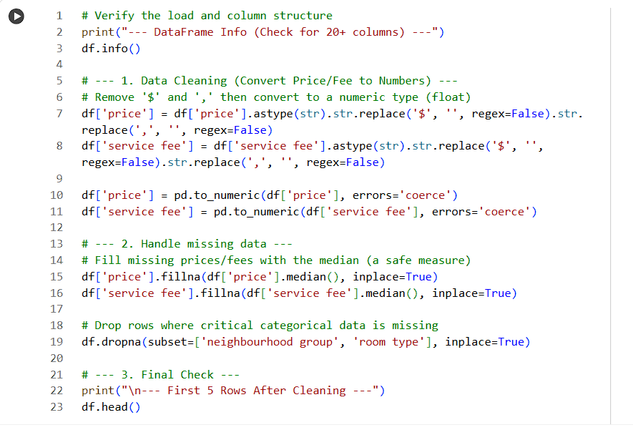
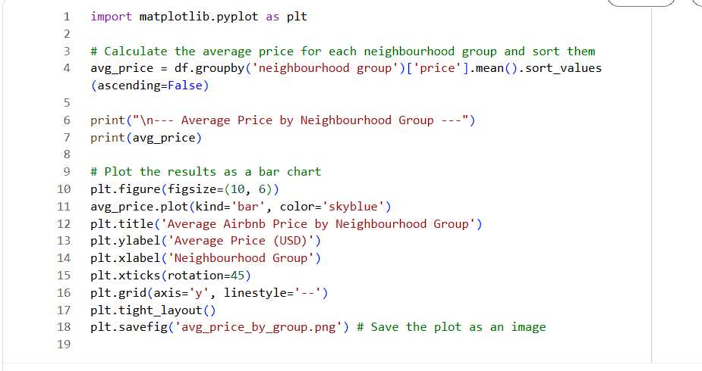
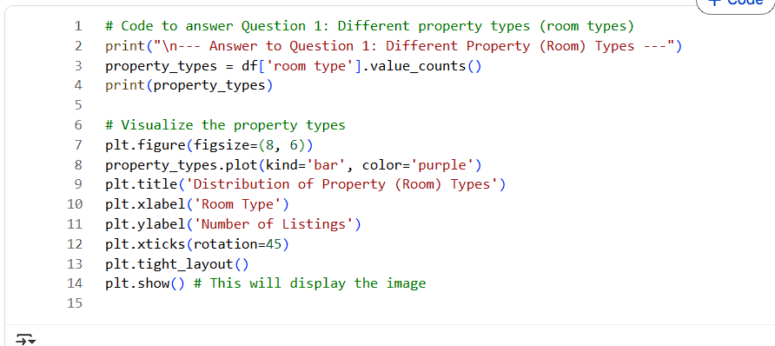
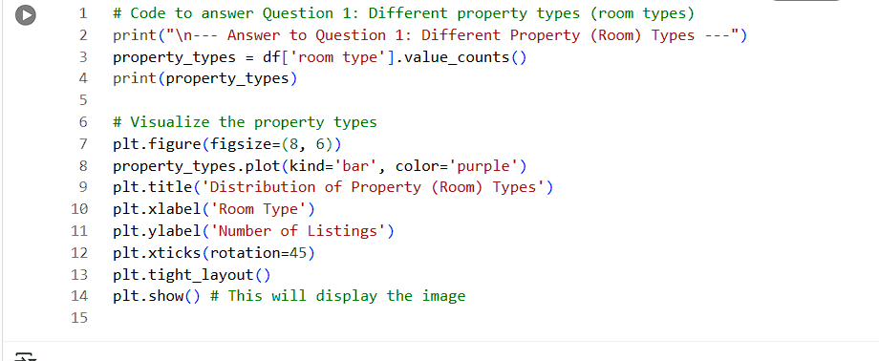
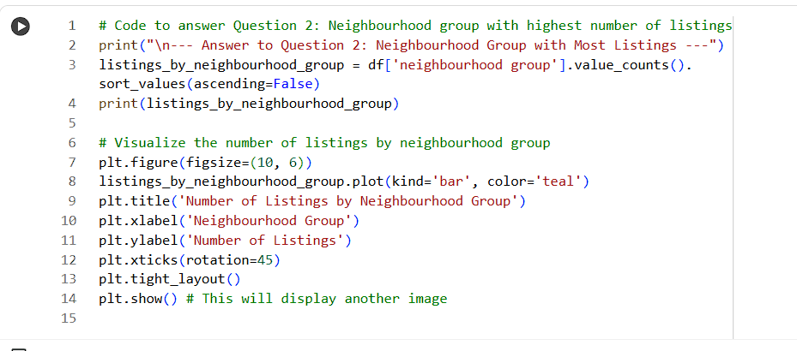
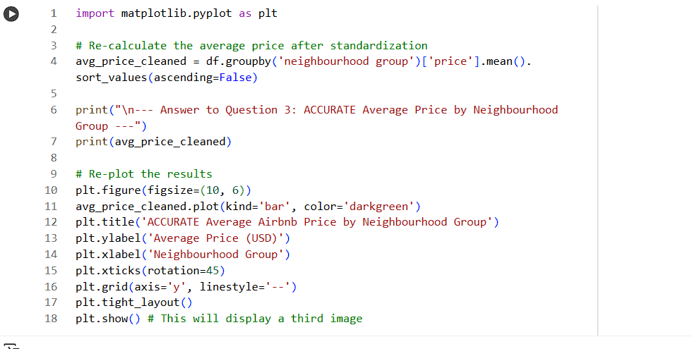
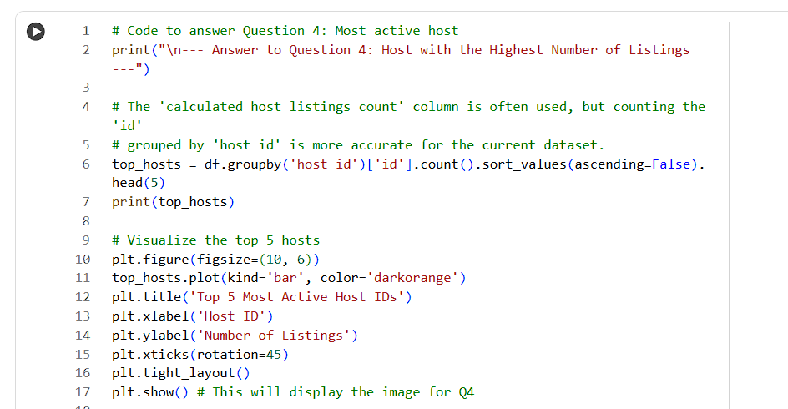
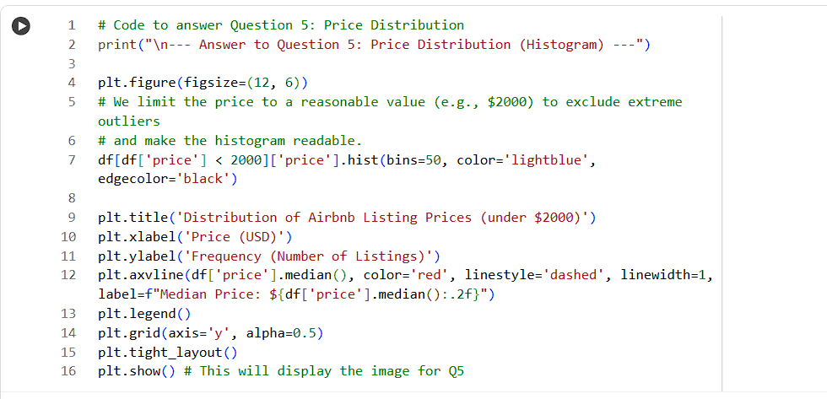
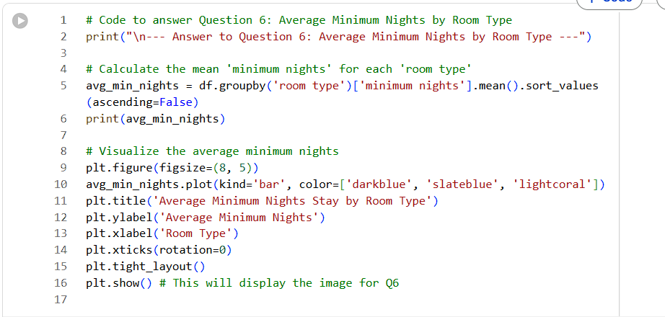
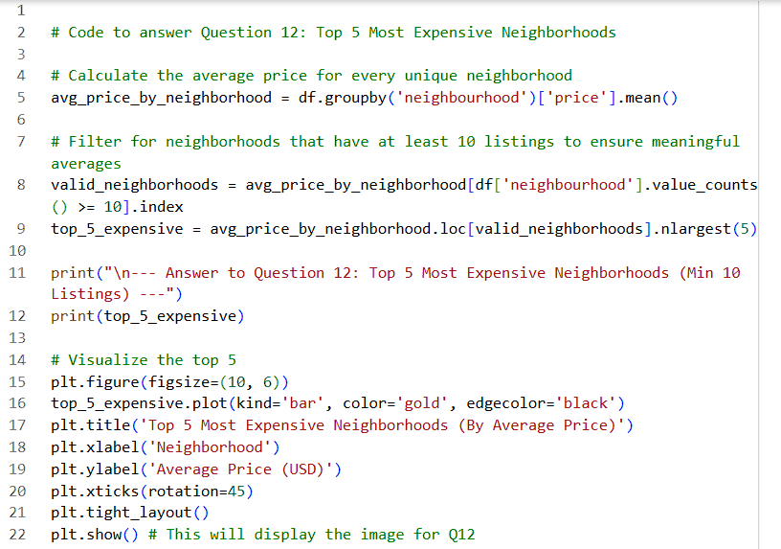
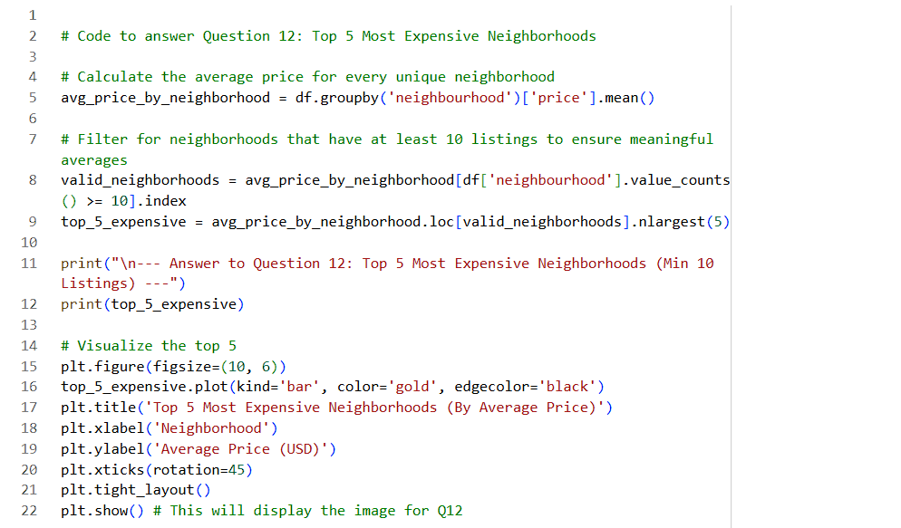
SOURCE CODE

Slide 7
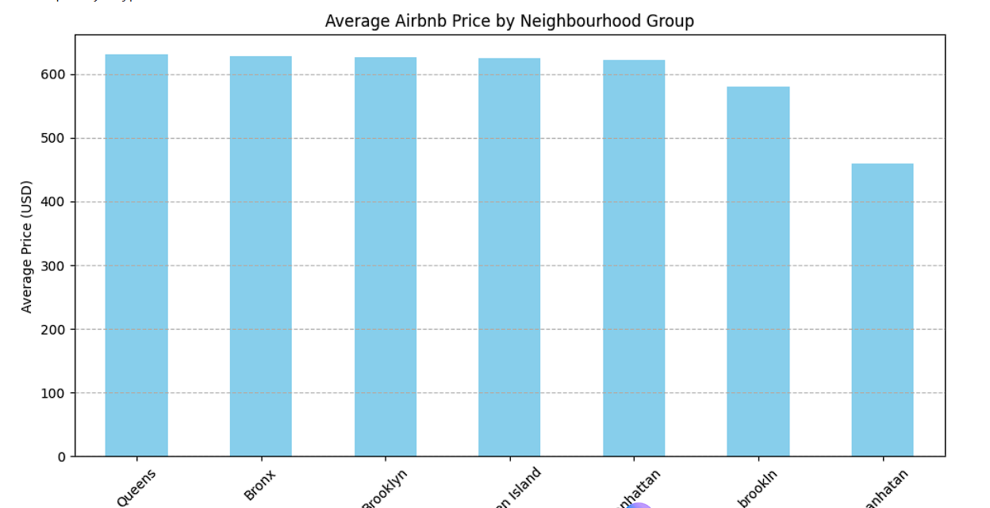
RESULTS
[Add screen shots of your code ]
Demo Link

Slide 8
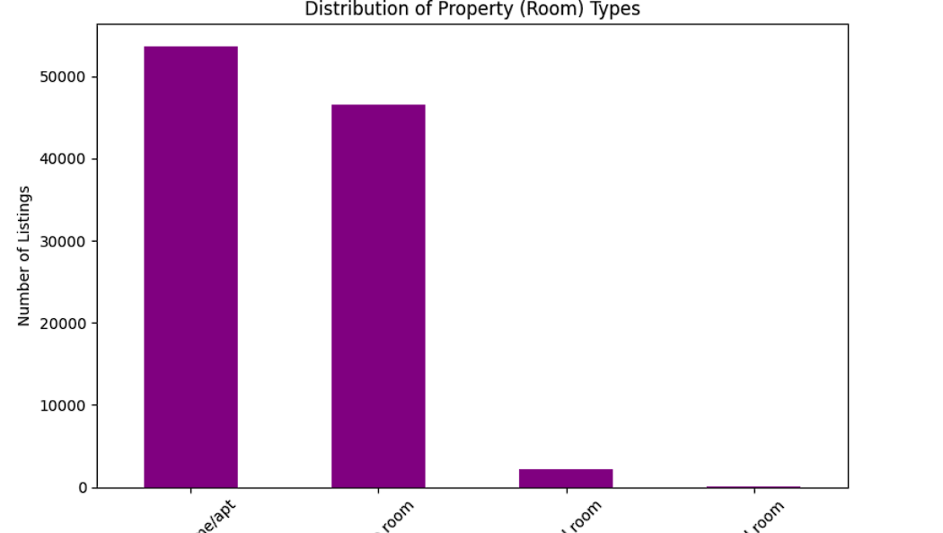
RESULTS
Demo Link

Slide 9
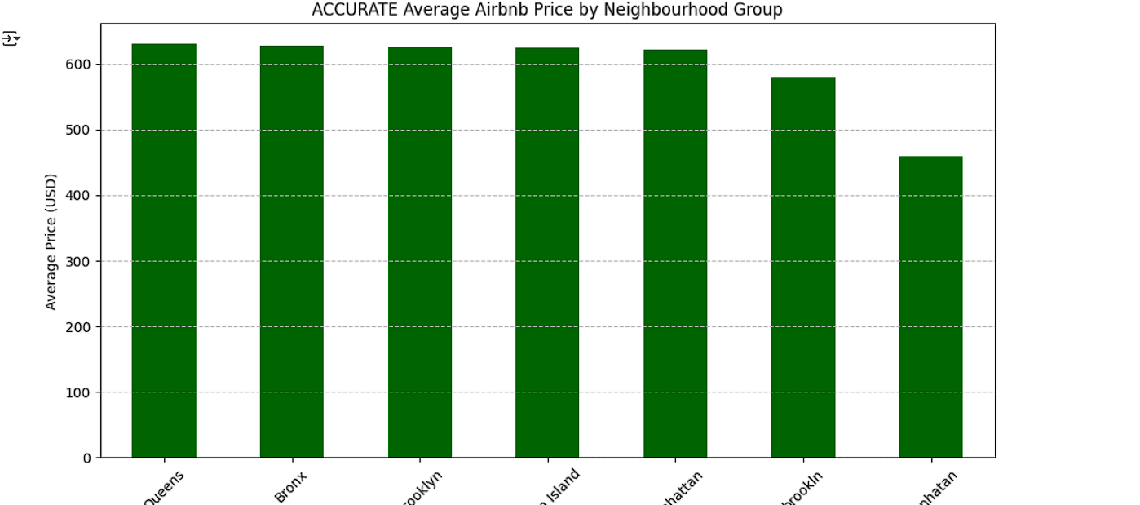
RESULTS
[Add screen shots of your code ]
Demo Link

Slide 10
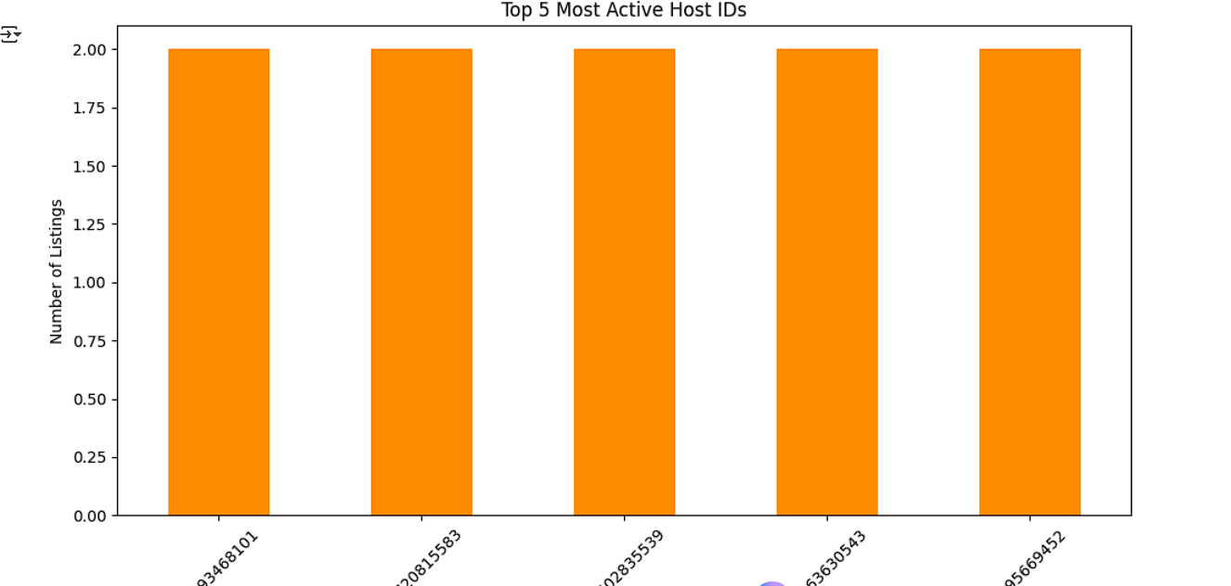
RESULTS
Demo Link

Slide 11
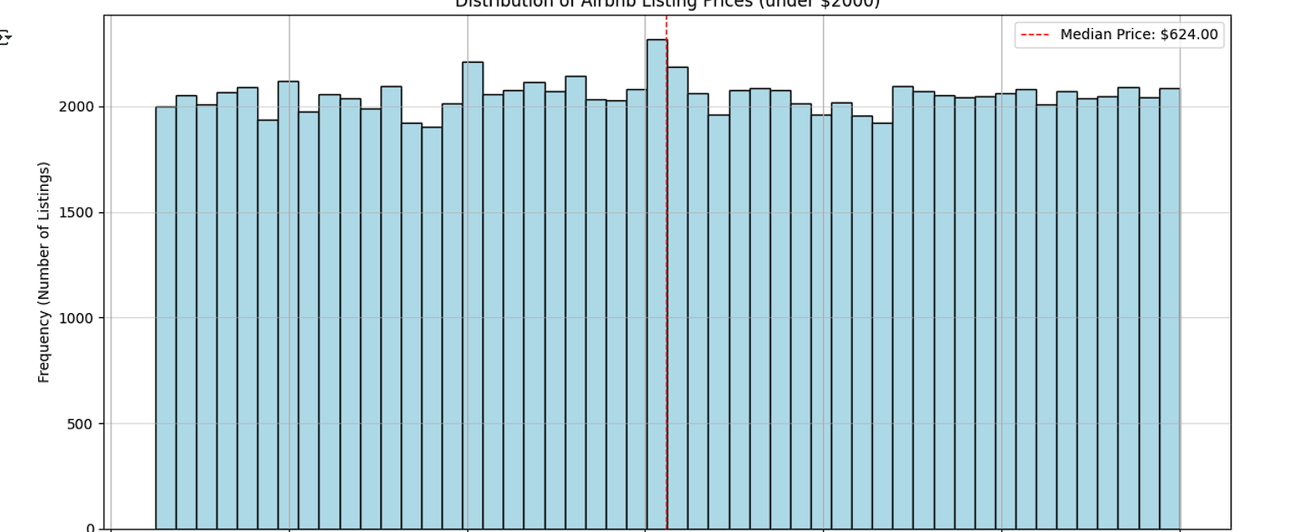
RESULTS
[Add screen shots of your code ]
Demo Link

Slide 12
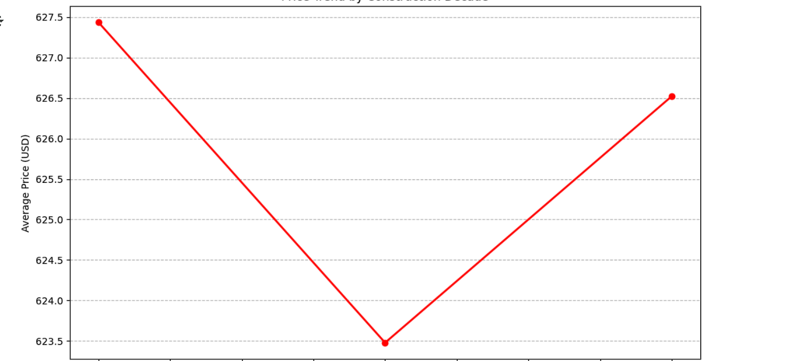
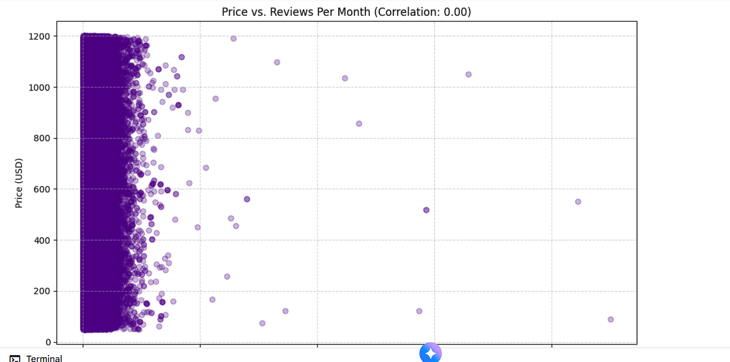
RESULTS
[Add screen shots of your code ]
Demo Link

Slide 13
Github repository
https://github.com/jishnusaireddy/VOIS_Aicte_Oct2025_Jishnusaireddy.git
.
.

Slide 14
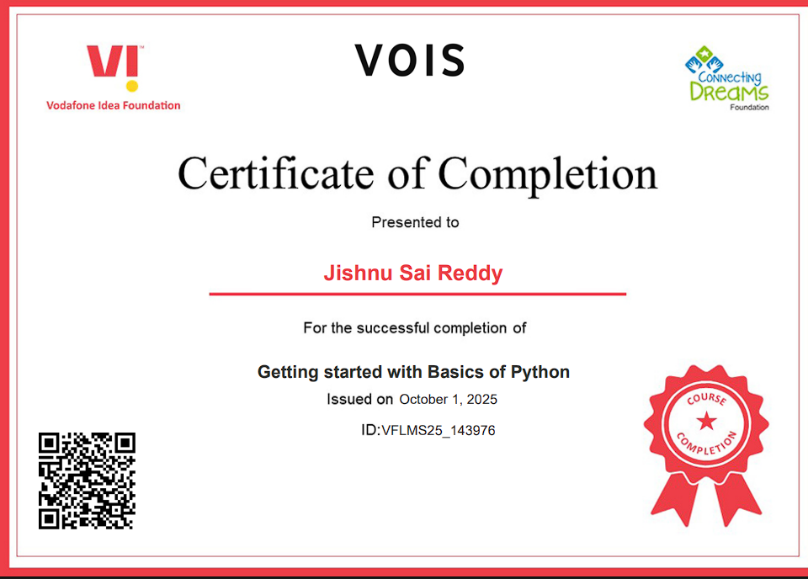
Getting started with Basics of Python
.
.

Slide 15
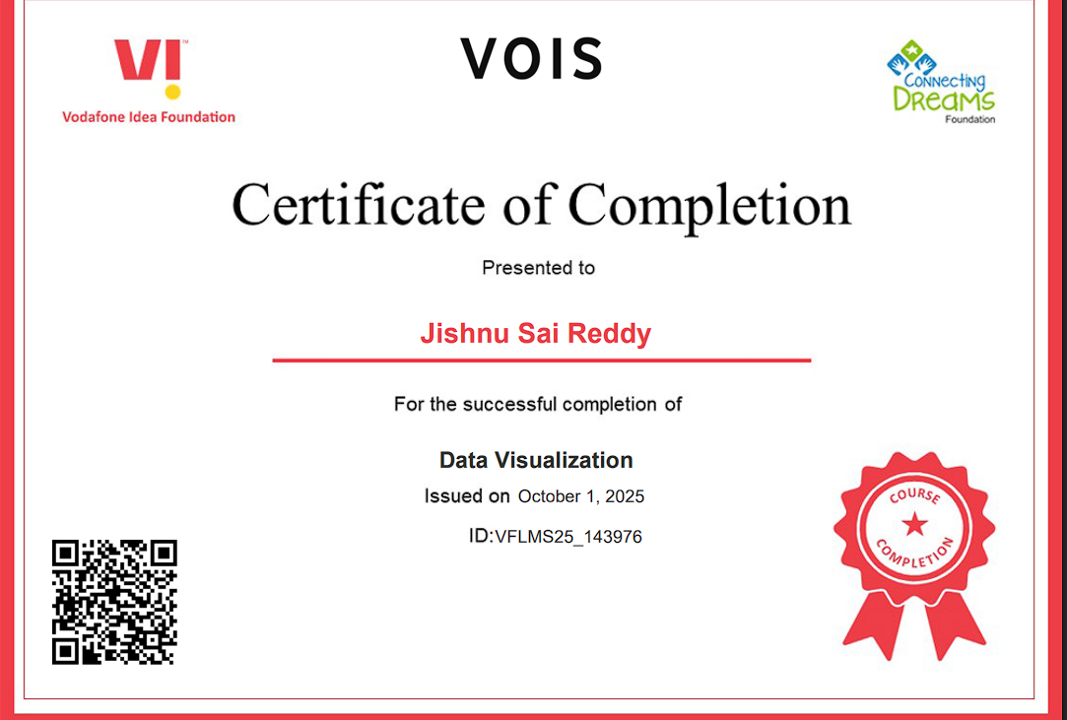
Data visualization
.
.

